Slide 1
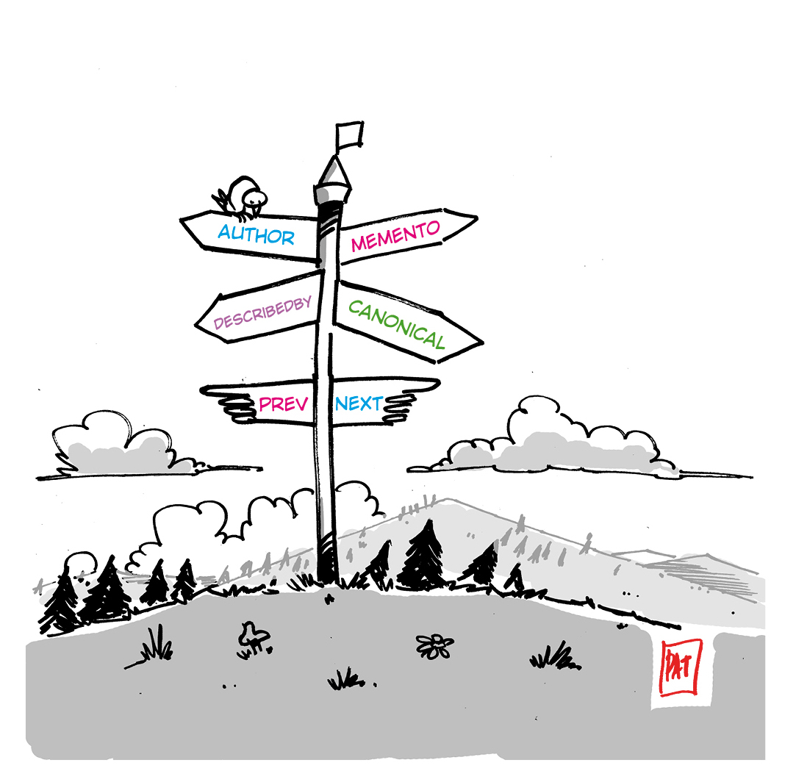
Signposting the Scholarly Web: An Overview
http://signposting.org
Slides prepared by:
Herbert Van de Sompel
@hvdsomp
Acknowledgments: Geoff Bilder, Shawn Jones, Martin Klein, John Kunze, Michael L. Nelson, David Rosenthal, Harihar Shankar, Simeon Warner, Karl Ward, Joe Wass
Cartoon by Patrick Hochstenbach
Signposting is funded by the Andrew W. Mellon Foundation
Updated Version November 2017

Slide 2
Outline
Introduction: HTTP Links
Signposting the Scholarly Web
Proposed Patterns
Putting it Together

Slide 3
HTTP Links
Mark Nottingham (2017) RFC8288: Web Linking.
http://tools.iets.org/rfc/rfc8288.txt

Slide 4
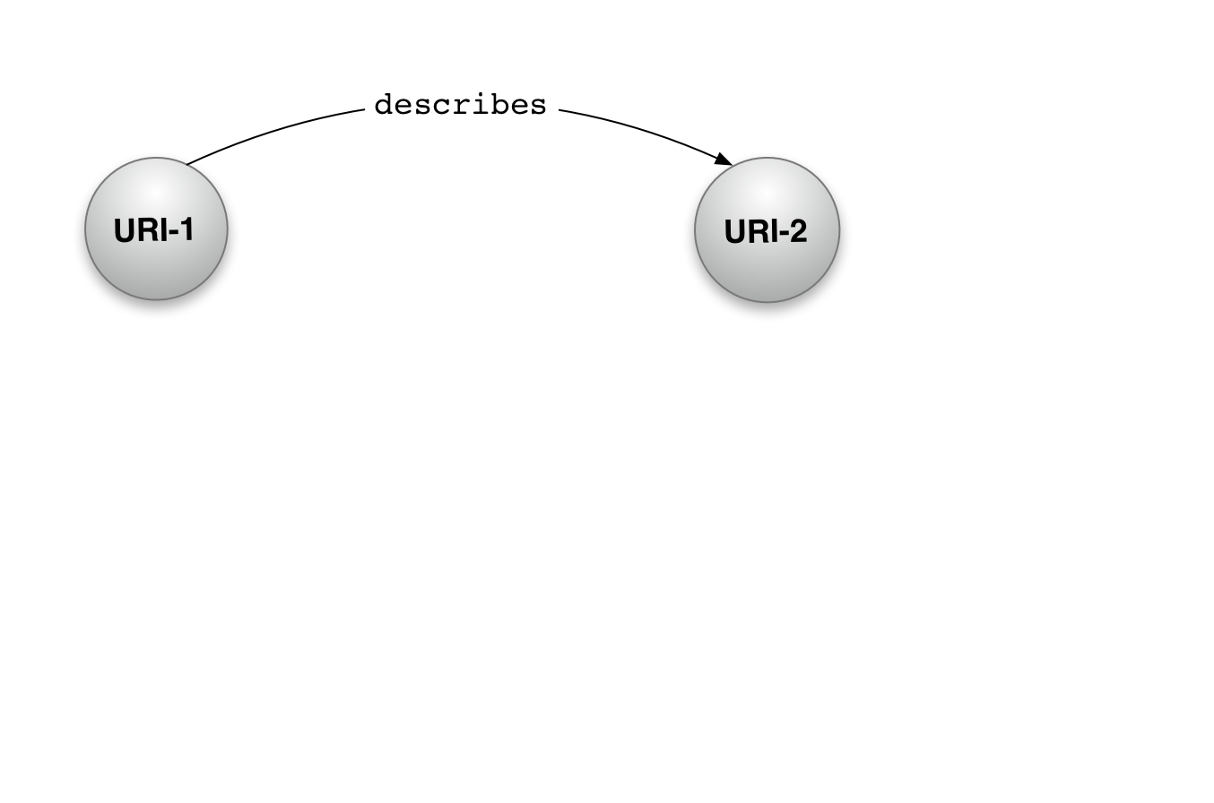
HTTP Links

Slide 5
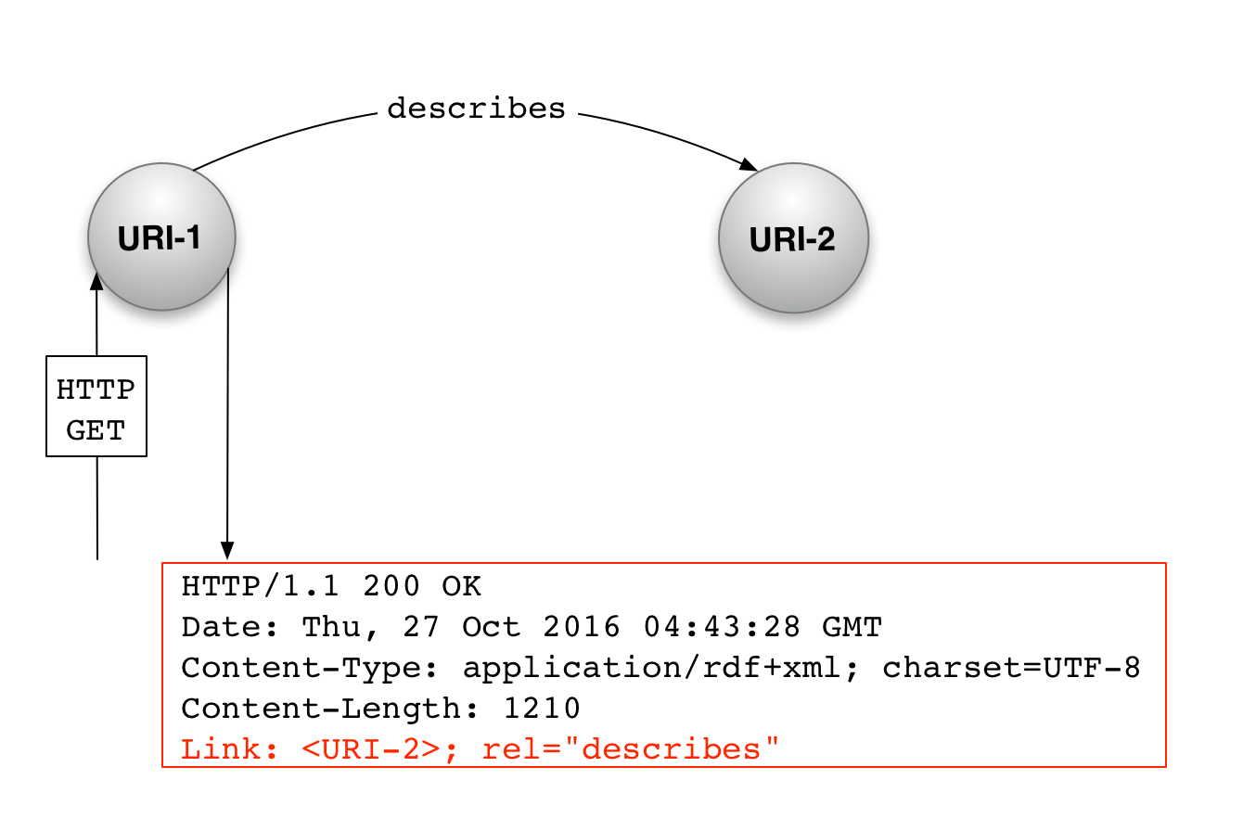
HTTP Links

Slide 6
HTTP Links Are Used
curl –I http://dbpedia.org/data/Reykjavik
HTTP/1.1 200 OK
Date: Thu, 27 Oct 2016 04:43:28 GMT
Content-Type: application/rdf+xml; charset=UTF-8
Content-Length: 1210
Link:
<http://creativecommons.org/licenses/by-sa/3.0>
; rel=“license",
<http://dbpedia.org/data/Reykjavik>
; rel="alternate"; type="text/n3",
<http://dbpedia.org/resource/Reykjavik>; rel="describes",
<http://mementoarchive.lanl.gov/dbpedia/timegate/http://dbpedia.org/
data/Reykjavik>
; rel="timegate"

Slide 7
HTTP Links Are Used
curl –I http://dbpedia.org/data/Reykjavik
HTTP/1.1 200 OK
Date: Thu, 27 Oct 2016 04:43:28 GMT
Content-Type: application/rdf+xml; charset=UTF-8
Content-Length: 1210
Link:
<http://creativecommons.org/licenses/by-sa/3.0>
; rel=“license",
<http://dbpedia.org/data/Reykjavik>
; rel="alternate"; type="text/n3",
<http://dbpedia.org/resource/Reykjavik>; rel="describes",
<http://mementoarchive.lanl.gov/dbpedia/timegate/http://dbpedia.org/
data/Reykjavik>
; rel="timegate"

Slide 8
HTTP Links Are Used
curl –I http://dbpedia.org/data/Reykjavik
HTTP/1.1 200 OK
Date: Thu, 27 Oct 2016 04:43:28 GMT
Content-Type: application/rdf+xml; charset=UTF-8
Content-Length: 1210
Link:
<http://creativecommons.org/licenses/by-sa/3.0>
; rel=“license",
<http://dbpedia.org/data/Reykjavik>
; rel="alternate"; type="text/n3",
<http://dbpedia.org/resource/Reykjavik>; rel="describes",
<http://mementoarchive.lanl.gov/dbpedia/timegate/http://dbpedia.org/
data/Reykjavik>
; rel="timegate"

Slide 9
HTTP Links Are Used
curl –I http://dbpedia.org/data/Reykjavik
HTTP/1.1 200 OK
Date: Thu, 27 Oct 2016 04:43:28 GMT
Content-Type: application/rdf+xml; charset=UTF-8
Content-Length: 1210
Link:
<http://creativecommons.org/licenses/by-sa/3.0>
; rel=“license",
<http://dbpedia.org/data/Reykjavik>
; rel="alternate"; type="text/n3",
<http://dbpedia.org/resource/Reykjavik>; rel="describes",
<http://mementoarchive.lanl.gov/dbpedia/timegate/http://dbpedia.org/
data/Reykjavik>
; rel="timegate"

Slide 10
HTTP Links Are Used
curl –I http://dbpedia.org/data/Reykjavik
HTTP/1.1 200 OK
Date: Thu, 27 Oct 2016 04:43:28 GMT
Content-Type: application/rdf+xml; charset=UTF-8
Content-Length: 1210
Link:
<http://creativecommons.org/licenses/by-sa/3.0>
; rel=“license",
<http://dbpedia.org/data/Reykjavik>
; rel="alternate"; type="text/n3",
<http://dbpedia.org/resource/Reykjavik>; rel="describes",
<http://mementoarchive.lanl.gov/dbpedia/timegate/http://dbpedia.org/
data/Reykjavik>
; rel="timegate"

Slide 11
HTTP Link Relation Types
Registered in IANA registry
Strings, e.g. license, alternate, describes, timegate
Requires a formal specification, e.g. RFC
Typically used for common relationships, generically specified
Provides broad, coarse grained interoperability
Minted by a community
URIs, e.g. http://xmlns.com/foaf/0.1/primaryTopic
Requires community agreement
Can be as specific as desired
Can provide community-specific, fine grained interoperability

Slide 12
HTTP Links Are Pretty Neat
Can uniformly be used for all MIME types
Accessible via HTTP HEAD (no content transfer):
Works for large resources and for restricted content
But HTTP Link not accessible to JavaScript
Links can be conveyed:
by-value, in the HTTP Link header
by-reference, by using a link in the HTTP header with the linkset relation type that points to a collection of links
HTTP Links provide guidance to machine agents intent on accomplishing a specific task

Slide 13
HTTP Links Alternative: Links in Resource Representation
Can only be done for media types that support inclusion of typed links, i.e. using the HTML <link> element in <head>
Requires HTTP GET (content transfer)
HTML <link> is accessible to JavaScript
For HTML pages, use both HTTP Link and HTML <link>
Links can be conveyed:
by-value, using HTML <link>
by-reference, by using an HTML <link> with the linkset relation type that points to a collection of links
HTML <link> elements provide guidance to machine agents intent on accomplishing a specific task

Slide 14
The linkset Relation Type ⁽¹⁾ Is Pretty Neat
Used to point to a collection of links in which the resource that provides the link participates
As link target or link source
Use when:
It is hard to provide links from within the application (it is easy to provide a linkset link using a web server rewrite rule)
It is easier to provide links from a dedicated application, operated by the custodian of the resource or by a third party
The number of links to be provided is large and risks making the HTTP header too bulky
(1) Wilde, E. and Van de Sompel, H (2017) Linkset: Media Types and a Link Relation Type for Link Sets https://datatracker.ietf.org/doc/draft-wilde-linkset/

Slide 15
Outline
Introduction: HTTP Links
Signposting the Scholarly Web
Proposed Patterns
Putting it Together

Slide 16
Signposting the Scholarly Web
Proposal:
Use HTTP Links to address some long standing problems regarding scholarly resources on the web, by interlinking them using appropriate relation types
Focus on a limited set of patterns to support uniformly:
Conveying a Persistent Identifier
Expressing the web boundary of a scholarly resource
Making bibliographic metadata discoverable
Conveying an Author Identifier
Conveying a resource type

Slide 17
Terminology
PID: Persistent Identifier
HTTP PID: the HTTP URI notation of the PID
entry page: the page where one ends up after following redirects from the HTTP PID, typically the landing page or full content HTML
resource: a web resource identified by an HTTP URI
constituent resource: a resource that is an integral part of a scholarly object, e.g. landing page, PDF, supporting data, …
bibliographic resource: a resource that provides a bibliographic description of a scholarly object

Slide 18
Outline
Introduction: HTTP Links
Signposting the Scholarly Web
Proposed Patterns
Putting it Together

Slide 19
Pattern: Identifier
Problem: When positioned at a constituent resource of a scholarly object, the associated HTTP PID is not available. As a result:
Entry page URIs are used for citation ⁽¹⁾
Applications such as annotation can not determine the HTTP PID associated with a constituent resource
Entry page URIs are used in social media and hence missed by alt metrics applications
Solution: provide cite-as link pointing at the HTTP PID
Applies to: entry page, all constituent resources
(1) Herbert Van de Sompel, Martin Klein, and Shawn Jones (2016) Persistent URIs Must Be Used to Be Persistent.
In: WWW2016. http://arxiv.org/1602.09102

Slide 20
Use HTTP Link with cite-as Relation Type
http://signposting.org/identifier/dryad/

Slide 21
Use HTTP Link with cite-as Relation Type
curl –I http://www.dlib.org/dlib/november15/vandesompel/11vandesompel.html
HTTP/1.1 200 OK
Date: Wed, 26 Oct 2016 12:36:37 GMT
Server: Apache/2.2.15 (CentOS)
Last-Modified: Thu, 19 Nov 2015 14:50:19 GMT
ETag: "205a5e-f5ef-524e5e0ab80c0"
Accept-Ranges: bytes
Content-Length: 62959
Content-Type: text/html; charset=UTF-8
Link: <https://doi.org/10.1045/november2015-vandesompel>
; rel=“cite-as”

Slide 22
Pattern: Publication Boundary
Problem: It is not possible to determine what the constituent resources of a scholarly object are
Preservation and text mining tools require portal-specific heuristic to find those constituent resources ⁽¹⁾
Can’t find the pathway from an HTTP PID directly to e.g. the PDF
Solution: provide item/collection links to interlink entry page and constituent resources; convey MIME types on item links
Applies to: All constituent resources of a scholarly object
(1) Van de Sompel, H., Rosenthal, D., and Nelson, M.L. (2016) Web Infrastructure to Support e-Journal Preservation (and More). http://arxiv.org/abs/1605.06154

Slide 23
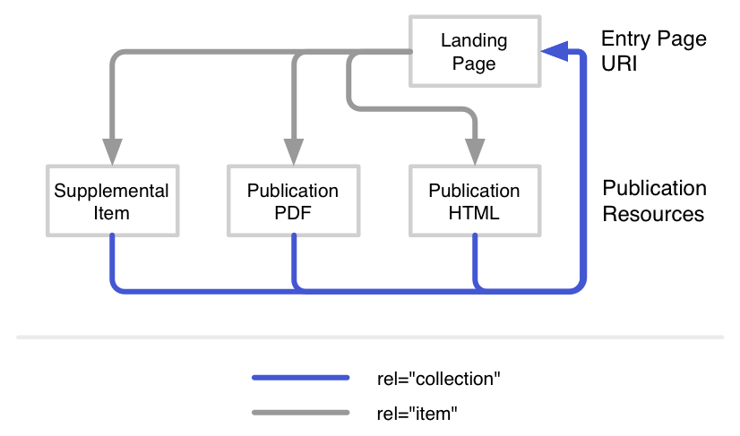
Use HTTP Link with item/collection Relation Type
http://signposting.org/publication_boundary/oxford/

Slide 24
Use HTTP Link with item/collection Relation Type
curl –I http://www.irrodl.org/index.php/irrodl/article/view/2179
HTTP/1.1 200 OK
Date: Sat, 17 Jun 2017 09:11:52 GMT
Server: Apache
Vary: Accept-Encoding
Accept-Ranges: none
Keep-Alive: timeout=5, max=200
Content-Type: text/html; charset=utf-8
Link:
<http://www.irrodl.org/index.php/irrodl/article/download/2179/3748>
; rel=“item” ; type=“application/pdf” ,
<http://www.irrodl.org/index.php/irrodl/article/view/2179/3747> ; rel="item"; type="text/epub+zip"

Slide 25
Pattern: Bibliographic Metadata
Problem: It is not possible to determine where the bibliographic resources that describes a scholarly object can be found
Preservation and reference manager tools require portal-specific heuristic to find those resources ⁽¹⁾
Solution: provide describedby/describes links to interlink entry page and bibliographic metadata resources
Applies to:
describedby: HTTP PID, entry page
describes: bibliographic resources
(1) Van de Sompel, H., Rosenthal, D., and Nelson, M.L. (2016) Web Infrastructure to Support e-Journal Preservation (and More). http://arxiv.org/abs/1605.06154

Slide 26
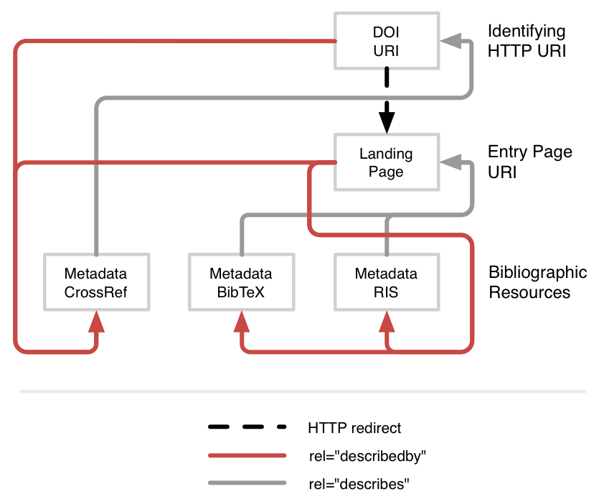
Use HTTP Link with describedby/describes Relation Type
http://signposting.org/bibliographic_metadata/springer/

Slide 27
Use HTTP Link with describedby/describes Relation Type
curl -I http://journals.plos.org/plosone/article?id=10.1371/journal.pone.0115253
HTTP/1.1 200 OK
Date: Sat, 17 Jun 2017 09:29:03 GMT
Server: Apache-Coyote/1.1
Content-Language: en-US
Keep-Alive: timeout=5, max=100
Content-Length: 308491
Content-Type: text/html;charset=UTF-8
Connection: keep-alive
Link:
<http://journals.plos.org/plosone/article/citation/bibtex?id=10.1371
%2Fjournal.pone.0115253>
; rel="describedby" ; type="application/x-bibtex" ,
<https://doi.org/10.1371/journal.pone.0115253>
; rel="describedby" ; type="application/vnd.citationstyles.csl+json"

Slide 28
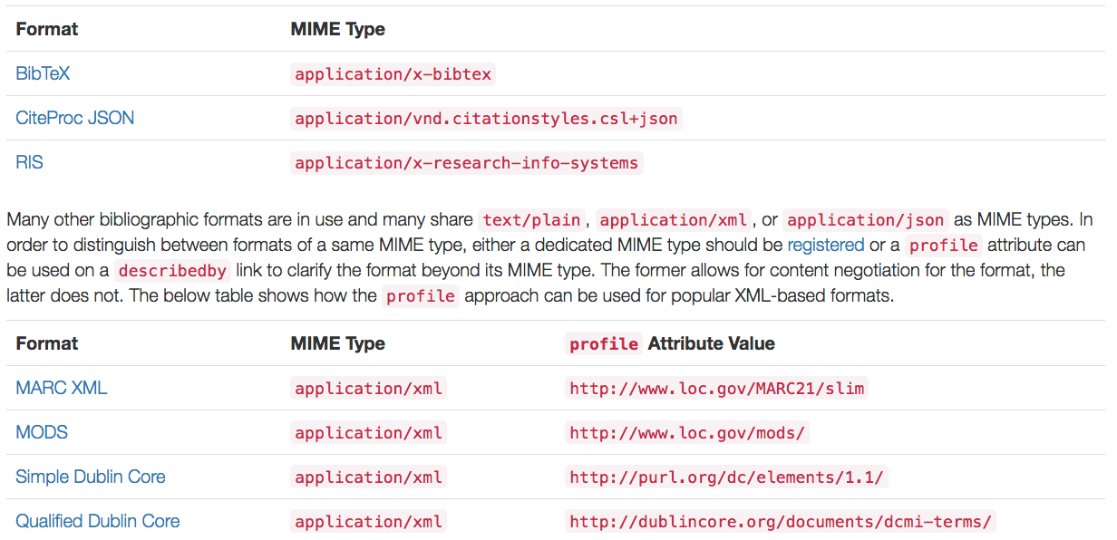
Bibliographic Metadata Conventions
http://signposting.org/conventions/

Slide 29
Outline
Introduction: HTTP Links
Signposting the Scholarly Web
Proposed Patterns
Putting it Together

Slide 30
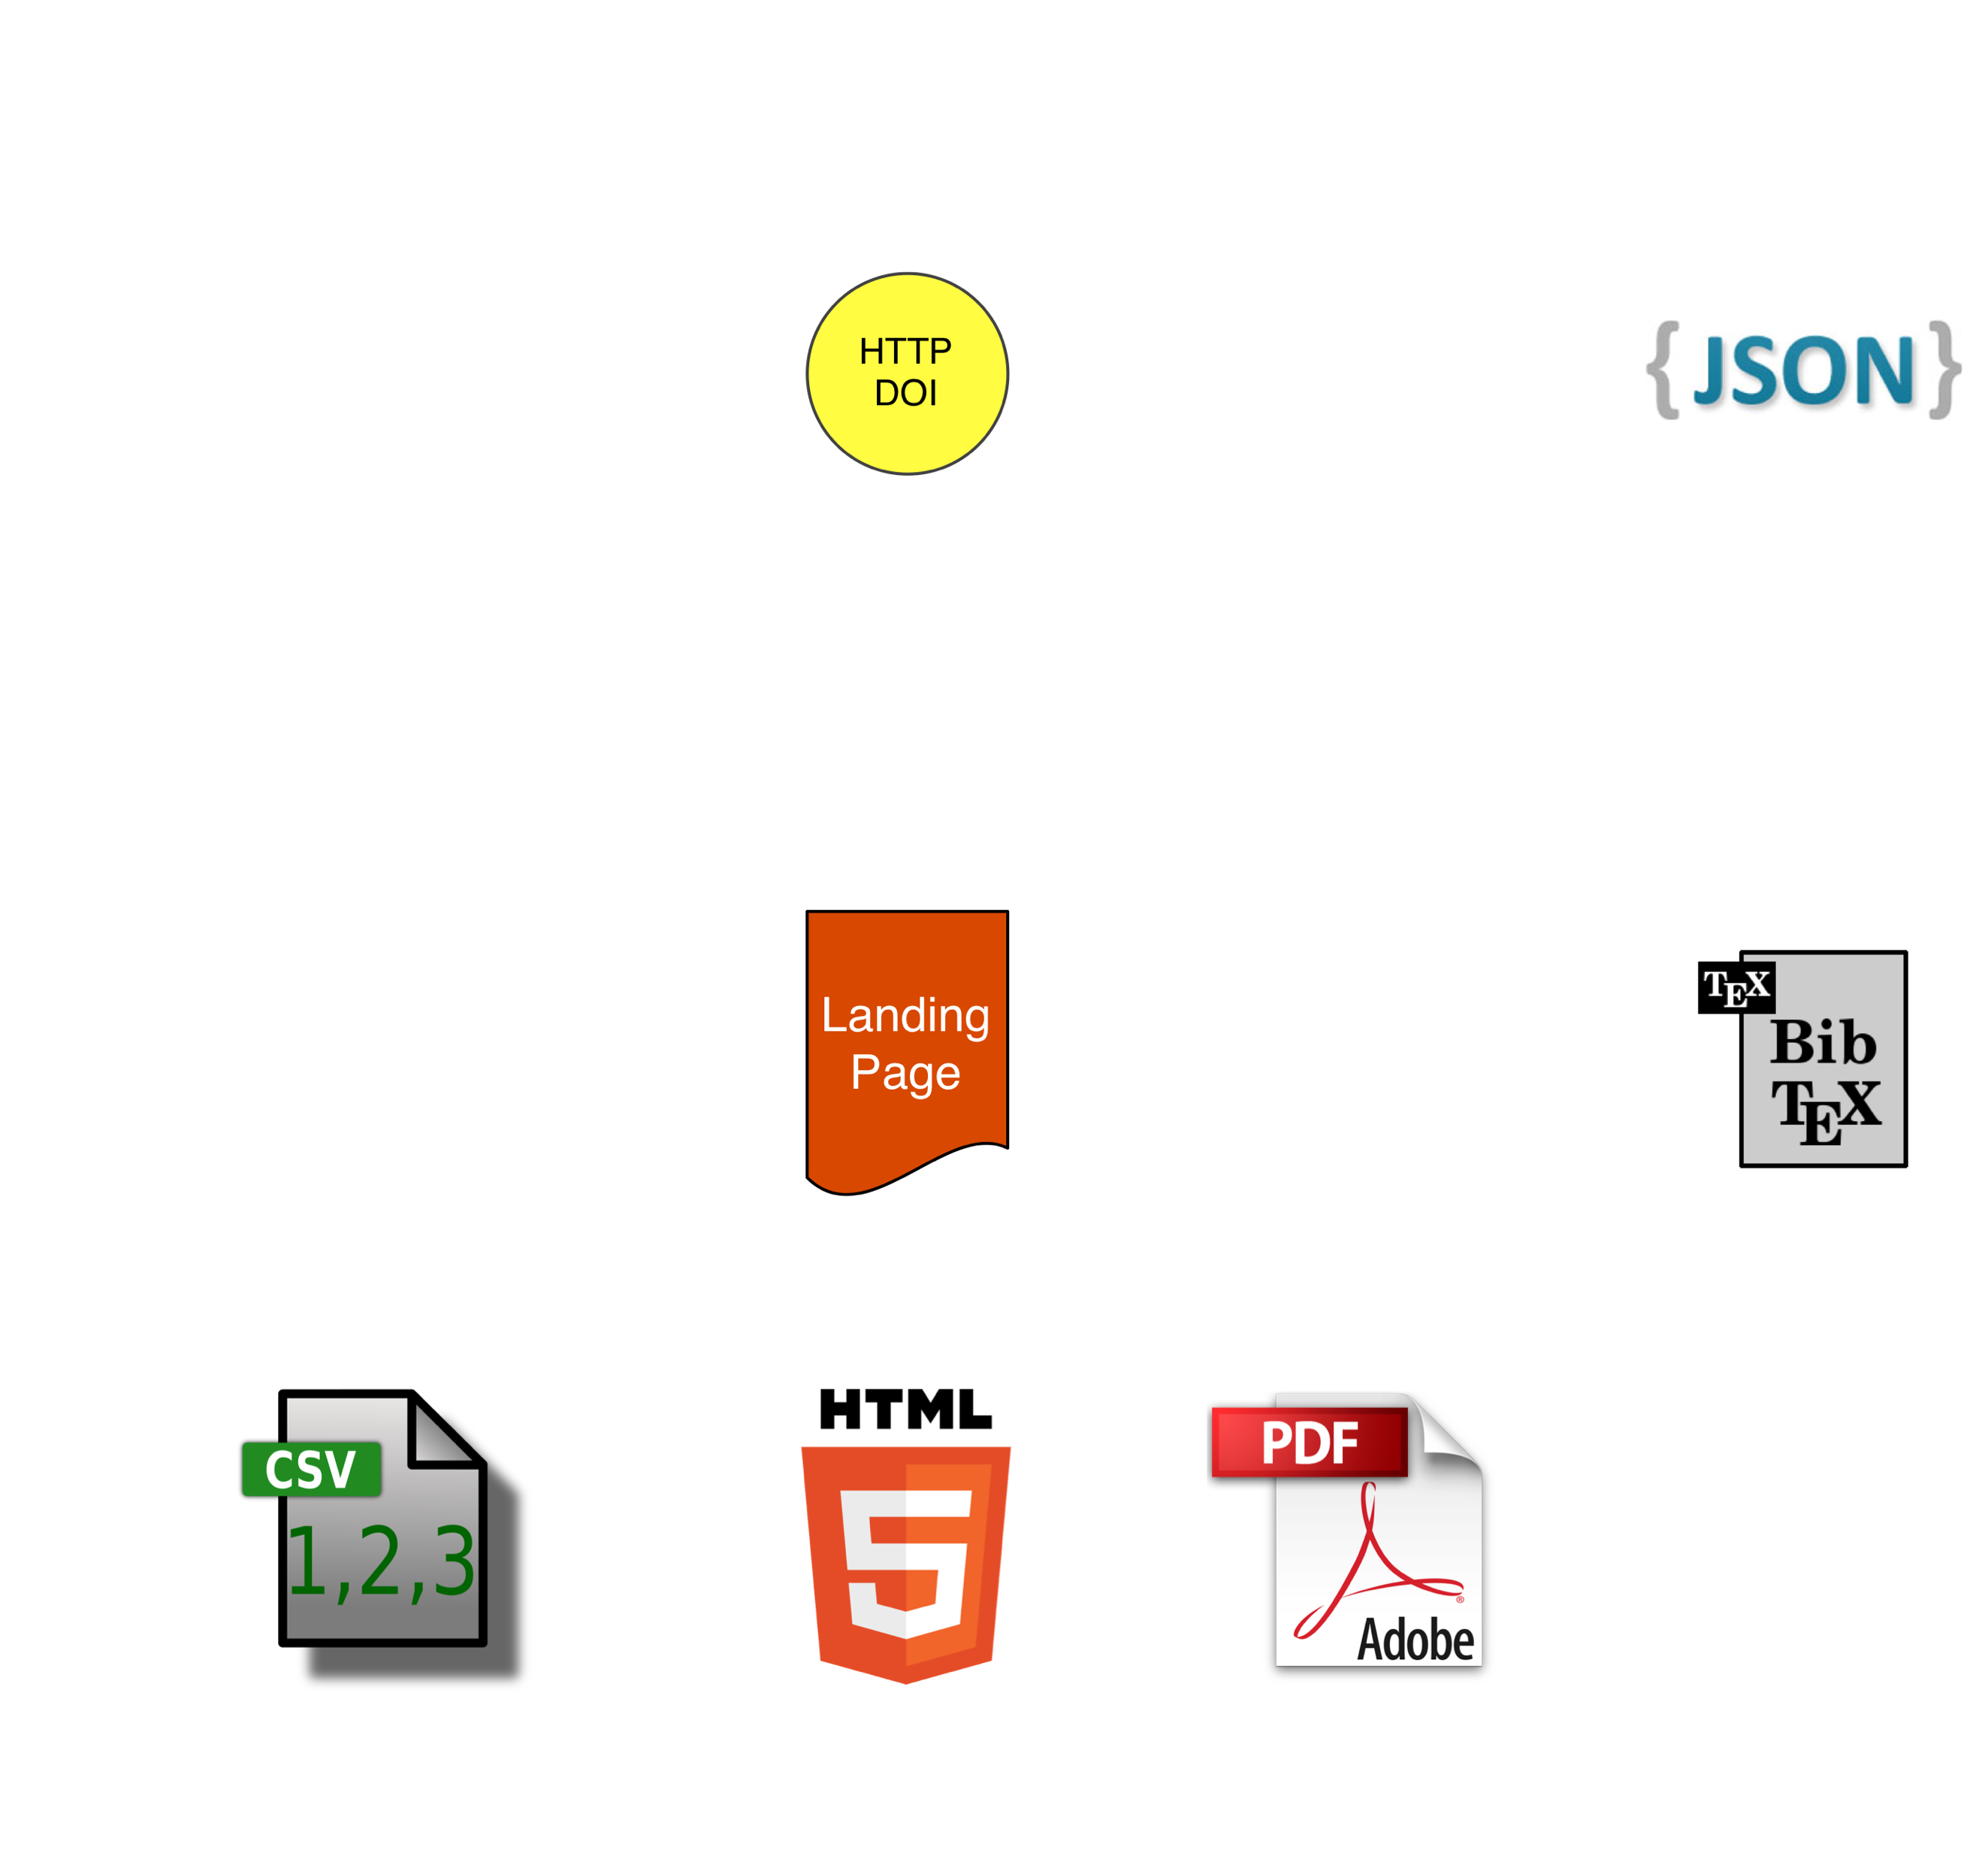

Slide 31
HTTP
PID
bibliographic
resources
constituent
resources

Slide 32
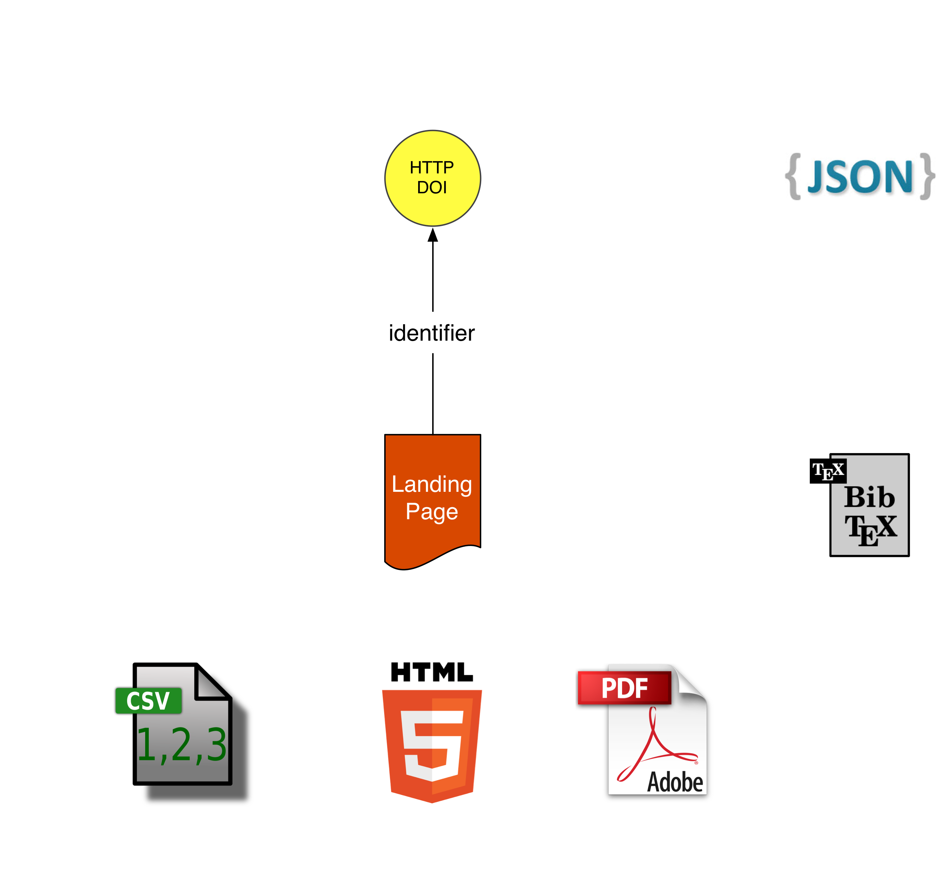
cite-as

Slide 33
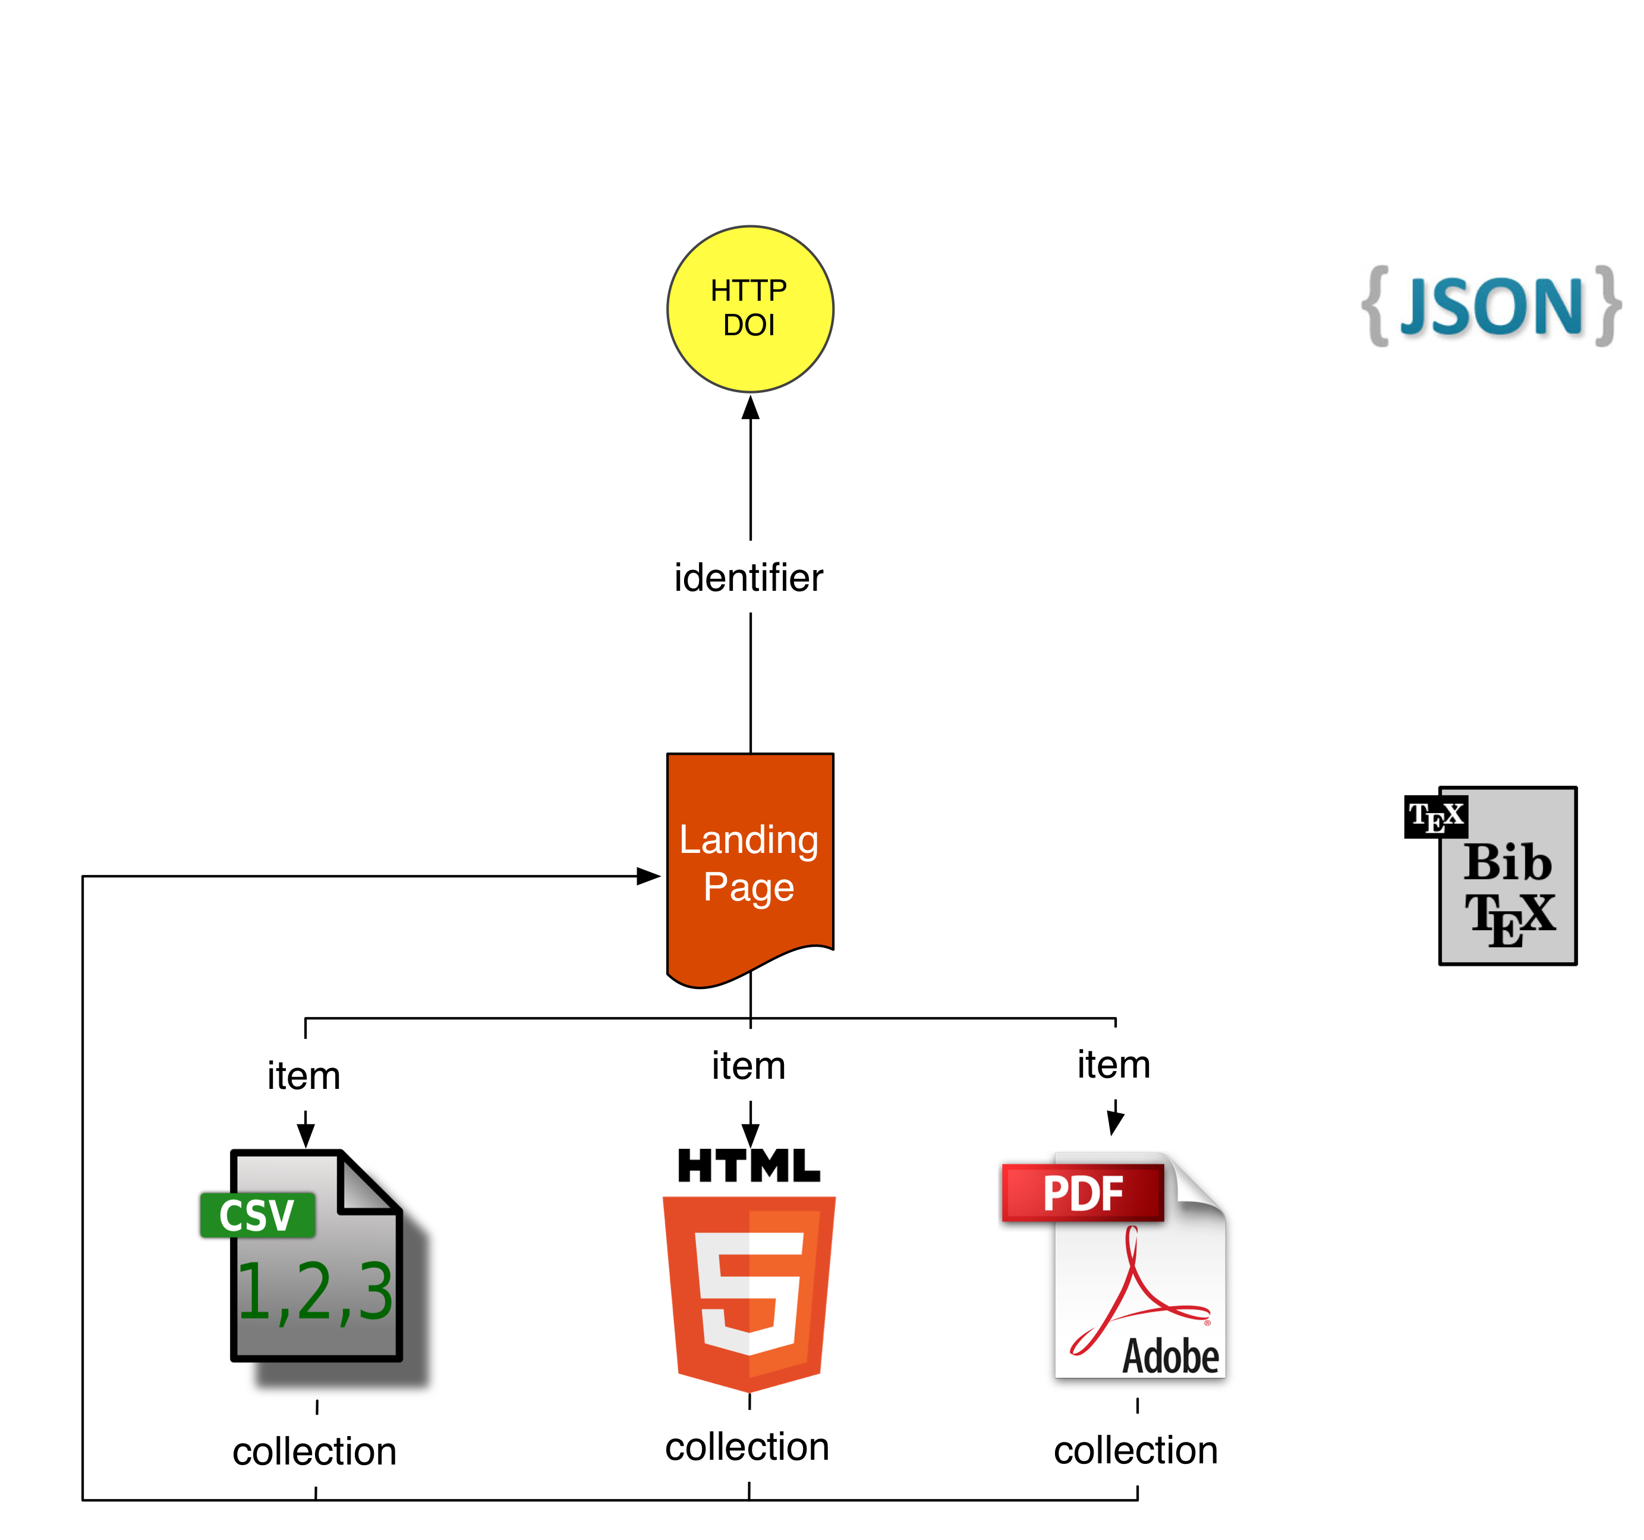
cite-as

Slide 34
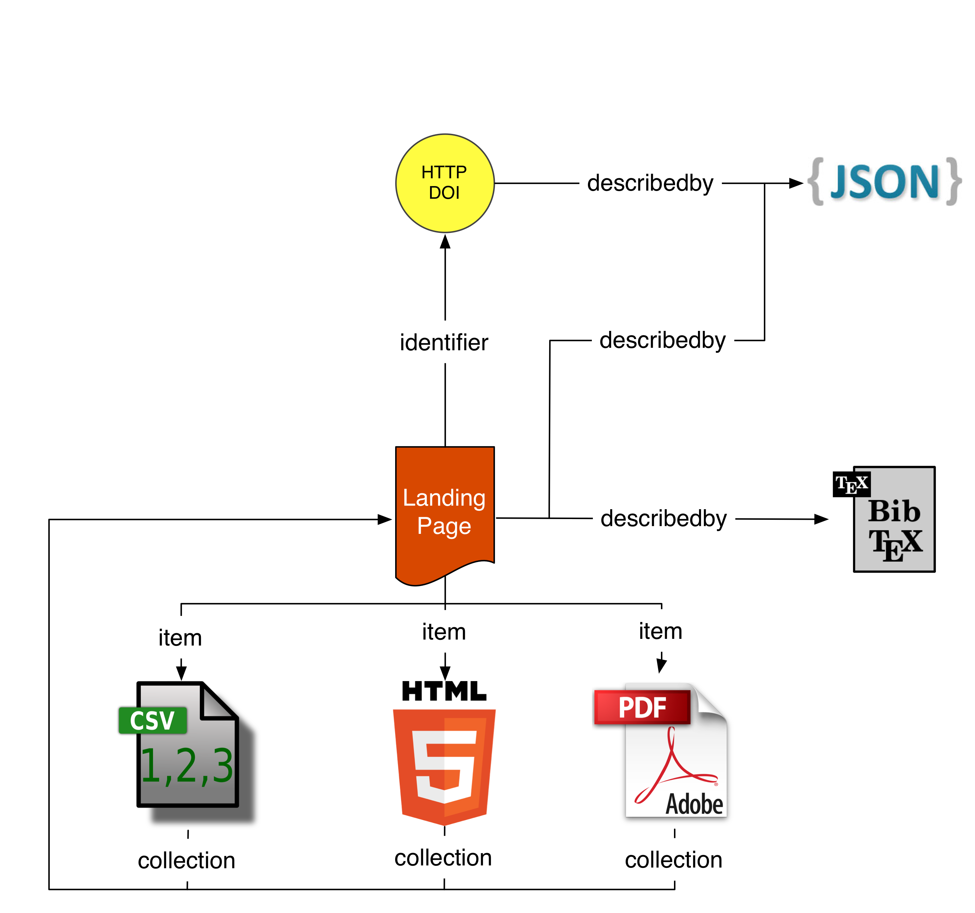
cite-as

Slide 35
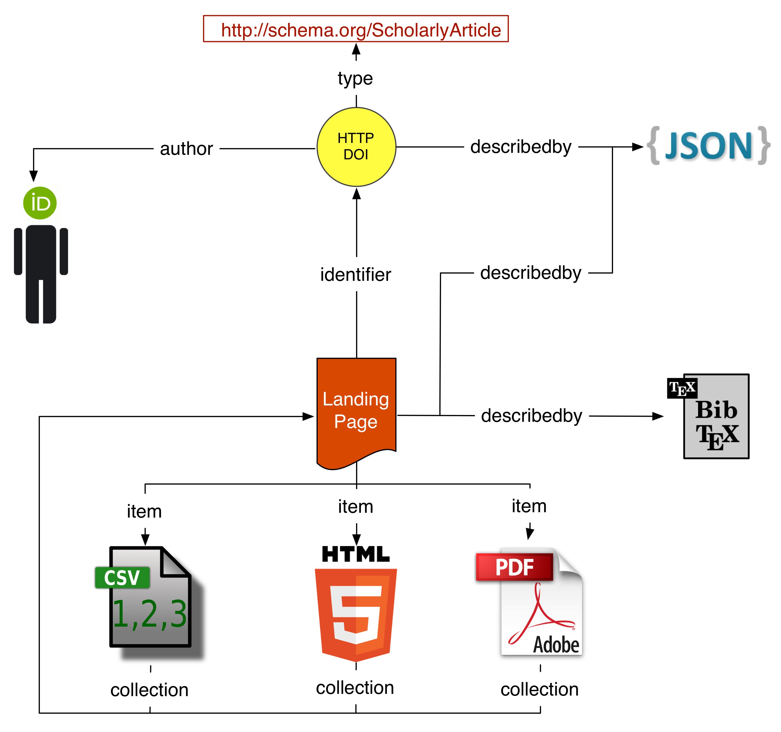
cite-as

Slide 36
Signposting the Scholarly Web: An Overview
http://signposting.org
Slides prepared by:
Herbert Van de Sompel
@hvdsomp
Acknowledgments: Geoff Bilder, Shawn Jones, Martin Klein, Michael L. Nelson, David Rosenthal, Harihar Shankar, Simeon Warner, Karl Ward, Joe Wass
Cartoon by Patrick Hochstenbach
Signposting is funded by the Andrew W. Mellon Foundation

